Slide 2
THE FOLLOWING PRESENTATION HAS BEEN APPROVED FOR
MICROSOFT INTERNAL AUDIENCES
BY THE COSMOS TEAM
THE PRESENTATION ADVERTISED HAS BEEN RATED
C
COSMIC
UNDER 17 REQUIRES ACOMMPANYING PARENT OR ADULT GUARDIAN

Slide 3
Cosmos Big Data at Microsoft
Saveen Reddy
2014/12/09
http://aka.ms/Cosmos

Slide 4
Cosmos
A Microsoft-internal platform for building big-data applications
The Promise
Enable customers to transform data of any scale into new business assets easily at low cost in the cloud.

Slide 5
 |  | Guiding Principles
Shared Data as a Service |  | Unified repository of high value data assets (documents/entities/user activity/people) Sharing by reference model (encourages experimentation between teams)
Approachable Compute |  | Lower the barrier to write efficient programs - auto parallelize Optimize execution for underlying infrastructure; isolate users from hardware failures Provide a natural evolution for SQL and .NET programmers
Scale at Lowest Cost |  | Large shared processing/storage clusters Optimize for maximizing utilization
Service Model |  | Easy to manage and operate for customers and Cosmos team No operations team (DRI model)

Slide 6
Storage
PETABYTES
Date | Logical (Exb)
2014/12 | 2.3
2014/10 | ​2.0
2014/07 | ​1.8
2013 | 1.015
2012 | 0.530
2011 | 0.283
2010 | 0.064

Slide 7
Storage Efficiency for Customer
Light Blue = Logical Storage
Dark Blue = Physical Storage
Cosmos uses compression to achieve better use of its physical storage.
Customers pay for Physical storage, not logical.

Slide 8
Ecosystem
7.3K+
Developers
100s
Feature Teams
1.3K+
Virtual Clusters

Slide 9
Batch Compute
Date | Scope
2014/12 | 199K
2014/10 | ​182K
2014/07 | ​​156K
2013 | 100K
2012 | 58K
2011 | 13K
2010 | 6K
327M
Compute Hours per month (For month of December 2014)

Slide 10
Capacity
Machines
Tokens
Date | Cosmos
2014/12 | 172K
2014/10 | 142K
2014/07 | 122K
Date | Count
2014/12 | 828K
2014/10 | ​798K
2014/07 | 550K
60%-80%
Average CPU Utilization
56s
Terasort on 1K Nodes

Slide 11
Interactive Compute (iScope)
750K
Jobs per Day
400+
Unique Users
7s
Time to query 500TB
stream in Cosmos

Slide 12
Data Centers & Clusters
Columbia Data Center
2 Clusters: Cosmos08 & Cosmos09
Only US Data Centers
Geo-replication of data between clusters
To support sharing scenarios
BCP
Quincy, WA
Cheyenne Data Center
1 Cluster: Cosmos11
Cheyenne, WY

Slide 13
Customers
Messenger
Windows
Live
Exchange
LCA
Yammer
Xbox Live
Windows Phone
Bing
SMSG
Office365
Microsoft
S
tores
Skype
CRM/Dynamics
STB Commerce Risk
STB Malware Protection
Large ecosystem of teams and engineers across the company
Mission critical production workloads alongside experimentation over the same data
Diverse set of scenarios and workload characteristics running in parallel

Slide 14
How Customers Use Cosmos

Slide 15
Log Processing
Front-End Machines
Logs
Logs
Logs
Logs
Logs
Logs
Cosmos
Raw Log Data
Cooked Log Data
Cleanup, Join, Remove Duplicates

Slide 16
Data Mining
Perform traditional analysis/reporting on large datasets
Cosmos
Cooked Log Data
System/ Operational Analytics
Flight analysis
Usage Trends

Slide 17
Curating Data
Generally back-end processing of served data
Search Front End
Online System
(example: a Search Engine)
Search Index
Cosmos
Catalogs & Index
Process and Update

Slide 18
Machine learning & Training
Scale out training algorithms over massive training data sets
Cosmos
Massive Data Set
Spam Samples
Speech Samples
Training
Training
Machine
Learning
Models
Spam Detection
Algorithms
Speech Recognition Algorithms

Slide 19
Cosmos 101

Slide 20
How Do You Reliably Store 700TB of Data?

Slide 21
Cosmos stores data as streams – a file-like structure
Streams are split apart into extents
Each extent can be up to 250MB in size
For availability and reliability extents are replicated (3 copies)
700TB
1
2
3
4
5
6
7
8
9
10
1
2
3
4
5
6
7
8
9
10
1
2
3
4
5
6
7
8
9
10
1
2
3
4
5
6
7
8
9
10

Slide 22
Tools

Slide 23
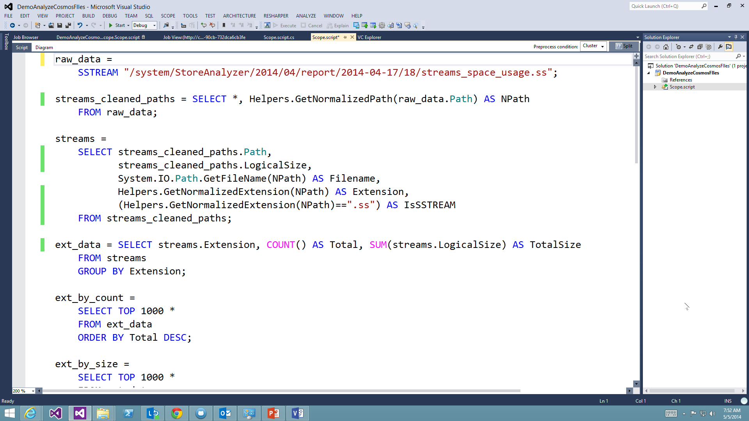
Scope Studio
Add-In for:
Visual Studio 2012
Visual Studio 2013
http://aka.ms/ScopeStudioInstall

Slide 24
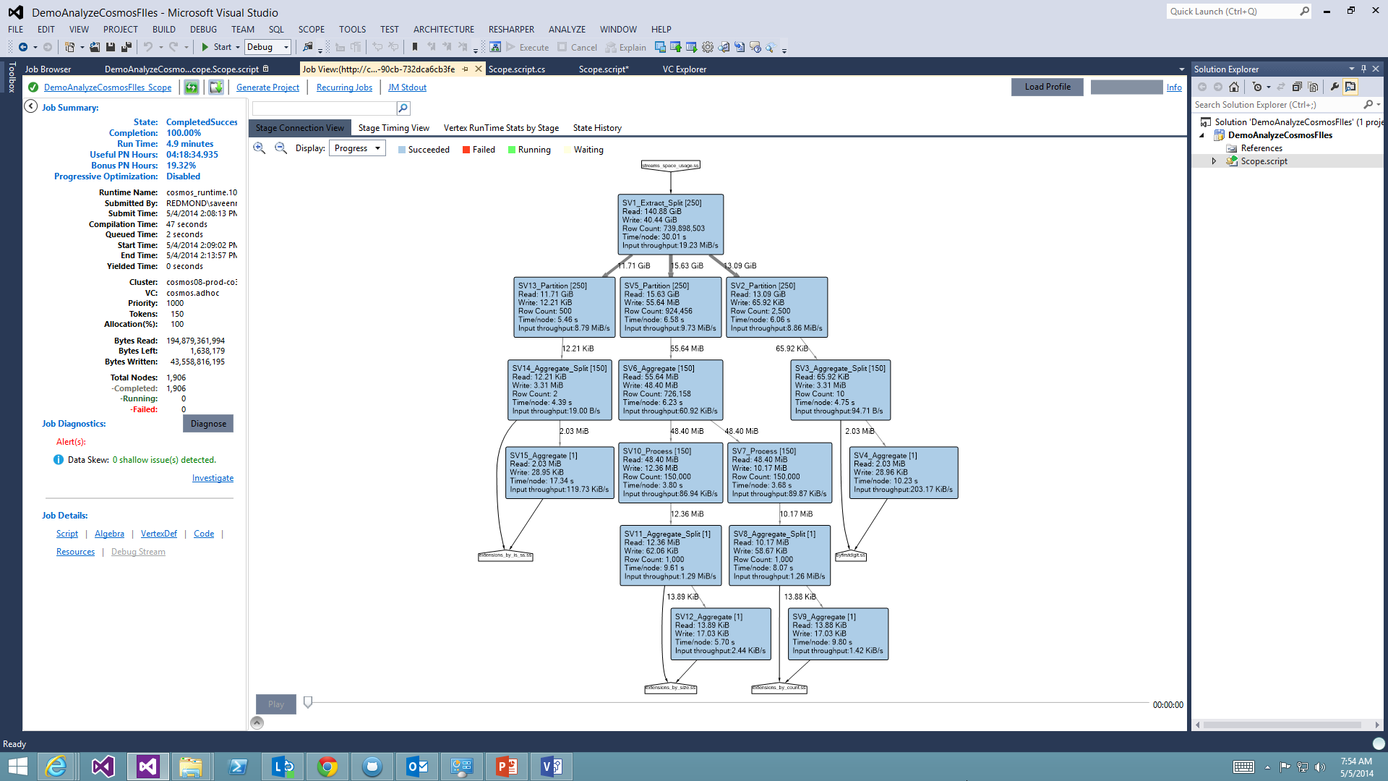
Scope Studio
Job Graph

Slide 25
Command-Line Tools
Cosmos PowerShell
http://aka.ms/CosmosPowerShell
SCOPE.EXE
Part of the Scope SDK
http://aka.ms/ScopeSDK

Slide 26
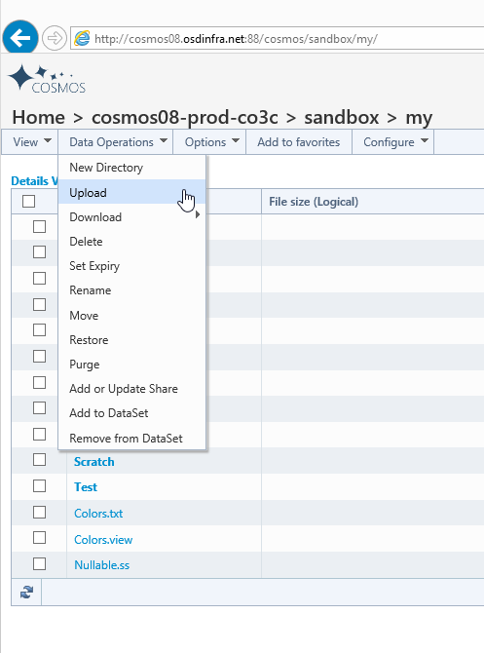
Web Portal
http://cosmos08.osdinfra.net/cosmos/sandbox/my
cosmos08 -> cluster
sandbox -> vc
my -> streams that belong to you

Slide 27
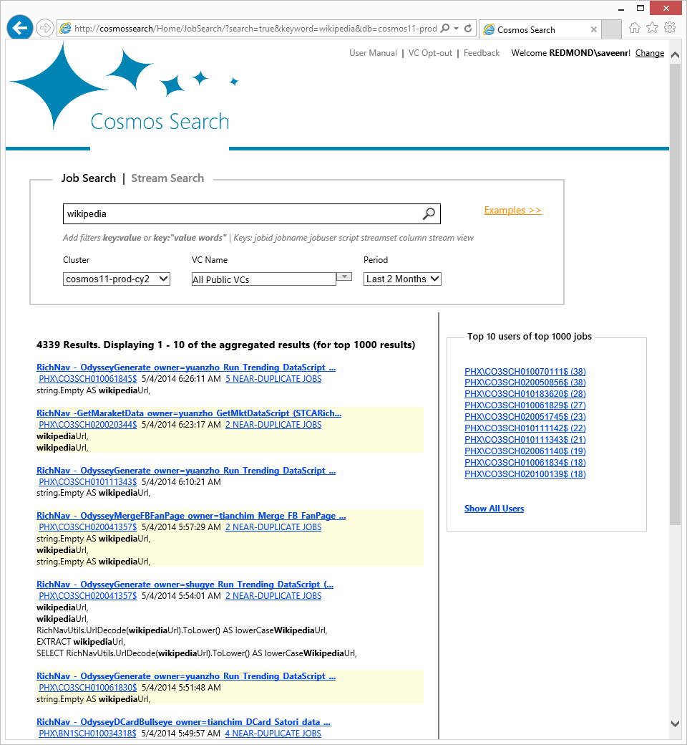
Cosmos Search
http://cosmossearch

Slide 28
Submitting a Job

Slide 29
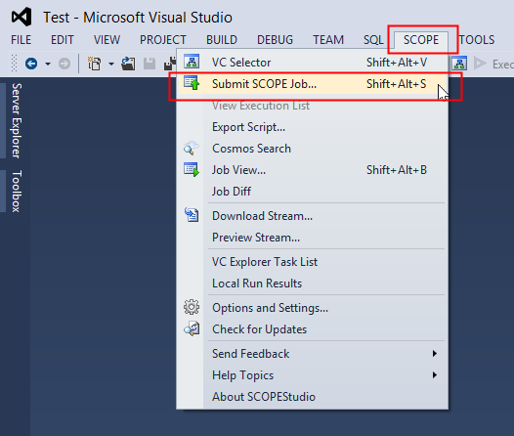
Via Code
Scope Studio
Cosmos PowerShell Submit-CosmosScopeJob d:\my.script vc://cosmos08/sandbox
SCOPE.EXE scope.exe submit –i d:\my.script vc://cosmos08/sandbox
Cosmos VCClient APIs VcClient.VC.Setup( "vc://cosmos08/sandbox", null, null); string script=“D:\\my.script” var submit_params = new ScopeClient.SubmitParameters(script_filename); var job_info = ScopeClient.Scope.Submit(submit_params);

Slide 30
Getting Data into Cosmos

Slide 31
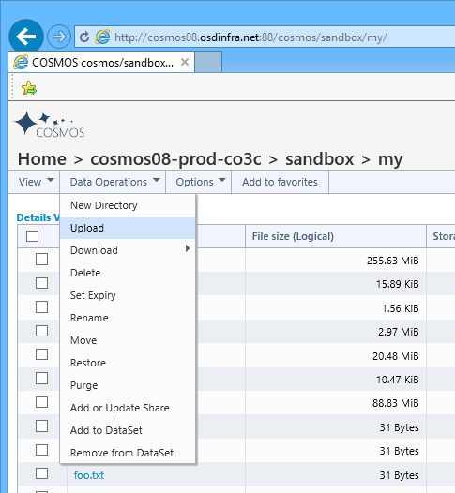
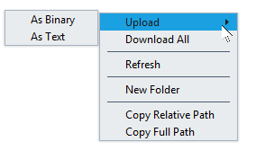
Uploading
Web Portal
Scope Studio
Cosmos VcClient API
VcClient.VC.Setup("vc://cosmos08/sandbox", null, null);
string filename = @"D:\data.txt";
string streamname = @"/my/data.txt";
bool compression = true; VcClient.VC.Upload(filename, streamname, compression);
Cosmos PowerShell Import-Module CosmosPS Import-CosmosStreamFromFile d:\data.txt vc://cosmosos/sandbox/my
SCOPE.EXE scope.exe copy d:\data.txt vc://cosmos08/sandbox/my

Slide 32
Cosmos Data Loader
By volume most data comes into Cosmos via Cosmos Data Loader (CDL)
There are two versions of CDL: CDLv1 and CDLv2 – use CDLv2
Machine 1
LOG
CDL
Stream
Machine 2
LOG
CDL
Machine 2
LOG
CDL

Slide 33
Basic Workflows

Slide 34
Batch Jobs
Scope is our language.
Submit a Scope script to your VC.
Job is queued and eventually starts and finishes writing its output.
Your Virtual Cluster
Job
RawData.CSV
Data.CSV
Upload
Submit
Download
Scope Script
RawData.CSV
Data.CSV

Slide 35
Interactive (iScope)
If you are performing very aggregated queries, we have a habit of getting interactive (1 second) response times.
Your Virtual Cluster
Data.ss
Execute
iScope API
ODBC Driver Enables direct access via BI Tools
Excel
SSRS

Slide 36
Clusters and Virtual Clusters

Slide 37
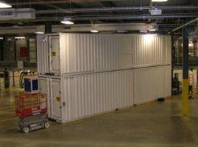
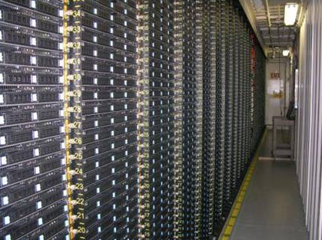
A Cluster is a physical set of machines
We have multiple physical clusters
Each cluster contains ~30K machines
Commodity hardware

Slide 38
A Physical Cluster
Imagine we have a cluster of 100 machines.
Each circle on the right represents one machine

Slide 39
Virtual Cluster
We do not reserve a set of machines.
Instead we assign you a virtual cluster with a number of tokens.
1 Token = a right to execute. Think of it as a VM (it’s NOT a VM).
20 token allocation = you are guaranteed 20 nodes

Slide 40
Bonus Computing
What happens when you are using up all your tokens?
If there are idle machines, Cosmos will try to apply them to your processing.

Slide 41
Bonus tokens cause job execution time to vary
Time to Complete Your Job
3 hours
Fewer
Bonus
Tokens
1 hour
Day 1
Day 2

Slide 42
How many tokens will my job need?
Calibration
On your VC, submit your job several times using no bonus tokens.
This establishes your baseline performance.
You have to tell us.
Communicated as a percentage of VC token allocation

Slide 43
Streams

Slide 44
Streams
Unstructured Streams
Plaintext (TSV, CSV, JSON, etc.)
Most streams in Cosmos
No schema stored in the text – first row can’t contain schema information
Structured Streams
.SS Extension
Contains schema information
Layout is optimized for performance and optimization
We generally want teams to move to using structured streams
Usually a little larger than equivalent unstructured stream
You CAN append to unstructured streams
You CAN’T modify steams in the middle.

Slide 45
Data Partitioning in Structured Streams
Imagine large stream that contains a column called Domain
And suppose we have three domains that show up.
a.com
b.com
c.com
Unstructured Stream
Domain is scattered across extents
Extent 1
Extent 2
Extent 3
a
a
a
b
b
c
b
c
c
Structured Stream
Partitioned by Domain
Records with same Domain placed on same extent
Extent 1
Extent 2
Extent 3
a
b
c
c
a
b
b
a
c

Slide 46
Compute Layer
Deep Dive

Slide 47
Scope Language
Influenced by SQL and relational concepts
Naturally parallelizable computation
Works great with .NET and C#
Very extensible
Rowset variable
EXTRACT indicates use of Unstructured Stream
RawData =
EXTRACT
Clicks:int,
Domain:string
FROM @“RAWWEBDATA.TSV”
USING DefaultTextExtractor();
WebData =
SELECT *,
Domain.Trim().ToUpper() AS NormalizedDomain
FROM RawData;
OUTPUT WebData
TO “WEBDATA.TSV”
USING DefaultTextOutputter();
Schema
Name + type
The input TSV file
Built-in object for reading TSVs
Compute a new Column
Create one rowset (WebData) from another (RawData)
Write the data to an output TSV

Slide 48
Creating a Structured Stream
RawData =
EXTRACT
Clicks:int,
Domain:string
FROM @“RAWWEBDATA.TSV”
USING DefaultTextExtractor();
WebData =
SELECT *,
Domain.Trim().ToUpper() AS NormalizedDomain
FROM RawData;
OUTPUT WebData
TO SSTREAM “WEBDATA.ss”
CLUSTERED BY Domain
SORTED BY Domain DESC;
SSTREAM keyword indicates a Structured Stream will be created
OUTPUT.ss is the name of the output stream
Data will be partitioned on the Domain column
To enhance performance
Sorting also enabled
On the Domain column for performance

Slide 49
Reading from a Structured Stream
SSTREAM keyword indicates we will be reading from a structured stream
WebData = SSTREAM “WEBDATA.ss”;
No schema is specified because the structured stream contains it.

Slide 50
Find the Top 100 Domains that Users Clicked On
WebData = SSTREAM “WEBDATA.ss”;
a = SELECT Domain, COUNT(…) AS TotalClicks FROM WebData GROUP BY Domain;
b = SELECT TOP 100 Domain, TotalClicks
FROM a
ORDER BY TotalClicks;
OUTPUT b
TO SSTREAM “ANALYSIS.ss”
CLUSTERED BY Domain
SORTED BY Domain DESC;

Slide 51
WITH UNSTRUCTURED STREAMS
a.com
b.com
c.com
a.com
b.com
c.com
a.com
b.com
c.com
a.com
b.com
c.com
Domains are randomly scattered across extents
Read
Read
Read
Read
Within an extent we can partially compute the aggregates
Partial Agg
Partial Agg
Partial Agg
Partial Agg
Put the data for each domain into the same place
Partition
Partition
Partition
Partition
EXPENSIVE
Now we can complete the aggregation per domain
Full Agg
Full Agg
Full Agg
EXPENSIVE
Sort
Sort
Sort
Sort the data
Top 100
Top 100
Top 100
Just get the top 100

Slide 52
WITH STRUCTURED STREAMS
The domains are partitioned into extents
a.com
b.com
c.com
c.com
…
…
No massive data shuffling
Read
Read
Read
Read
We can do the full aggregation immediately
Full Agg
Full Agg
Partial Agg
Partial Agg
Sort
Sort
Full Agg
Top 100
Top 100
Sort
c.com took spanned several extents
Top 100
Top 100

Slide 53
Job Execution

Slide 54
Layers
Scope Layer
Scope Compiler + Scope Optimizer
Optimizer makes decisions about execution plan and parallelism
Creates job algebra
Scope runtime executes the algebra
Execution Layer
Jobs queues in virtual cluster
Deploys work close to data
Processing nodes (PNs) host execution vertices running Scope code
Store Layer
Extent nodes (ENs) store and compress replicated extents on disk
Cosmos Store Manager (CSM) handles names, streams, & replication

Slide 55
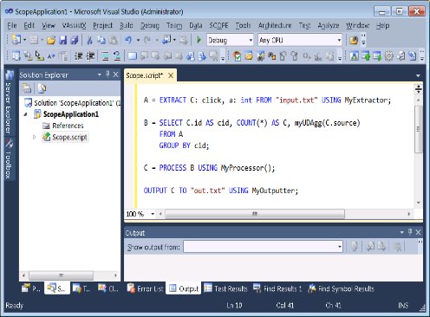
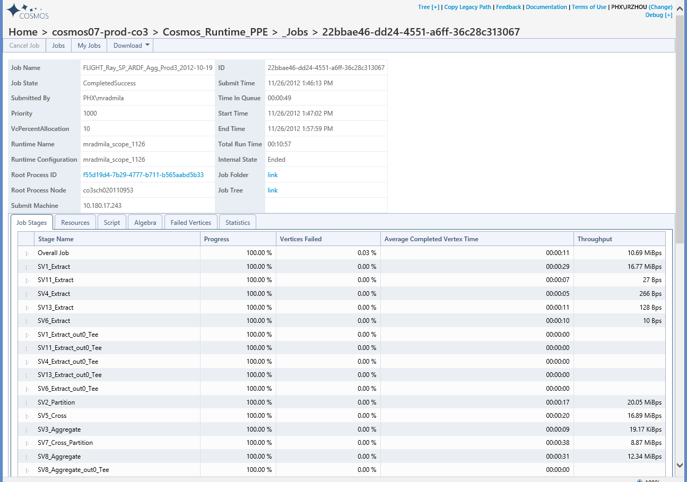
Query Life
Cosmos Front-End Service
Compiler
Optimizer
Scope Studio
Scheduler
Runtime
Web Interface / API

Slide 56
Cosmos Community

Slide 57
Cosmos Discussion
Cosmos discussion is an email distribution group.
This DG gets lots of email every day.
Most Cosmos users are a member of this DG.
cosmdisc@microsoft.com

Slide 58
Cosmos Announcement
This DG only gets email every couple of weeks.
It is primarily used for the Cosmos team to make big announcements.
cosmosan@microsoft.com

Slide 59
Cosmos Scope Yammer Group
There’s growing usage of our Yammer group (220 members as of March 2014)
The traffic is moderate.
Over time we expect more people to take advantage of the Yammer group than use email only.
http://aka.ms/CosmosYammer
You can send mail to this group via:
cosmosscope+microsoft.com@yammer.com

Slide 60
Wrap Up

Slide 61
Recap
How People Use Cosmos
How Cosmos Stores Files
Clusters & Virtual Clusters
The Scope Language
The Importance of Data Partitioning
Job Execution

Slide 62
Try Cosmos Now!
Try it on your own box
No special permissions are necessary, Anyone with MS Corpnet access can do this.
Step 1: Install Visual Studio 2012 or 2013
Step 2: Install Scope Studio
http://aka.ms/ScopeStudioInstall
Step 3: Follow along with the Scope Tutorial (Chapter 1)
http://aka.ms/ScopeTutorial
Play in the Sandbox
We have a special VC called the “Sandbox” used for learning.
(Not for production work or testing.)
Step 1: Ask for permission to play in the Sandbox
http://aka.ms/CosmosSandbox
Step 2: Install Scope Studio
http://aka.ms/ScopeStudioInstall
Step 3: Browse the Sandbox once you have access
http://cosmos08.osdinfra.net/cosmos/sandbox

Slide 63
Links
Our website
http://aka.ms/Cosmos
Presentations
http://aka.ms/CosmosPresentations
Scope Tutorial
http://aka.ms/ScopeTutorial
Code Samples
http://aka.ms/CosmosCodeSamples
Scope Studio
http://aka.ms/ScopeStudioInstall
Request access to sandbox
http://aka.ms/CosmosSandbox
Yammer Group
http://aka.ms/CosmosYammer
Join the discussion
cosmdisc@microsoft.com
Get Cosmos Announcements
cosmosan@microsoft.com

Slide 64
Need more Information?
Contact me if you need anything
saveenr@microsoft.com
Presentations with slides and videos are here
http://aka.ms/CosmosPresentations

Slide 65
Questions

Slide 67
Backup

Slide 68
Scope Studio
(Add-In for Visual Studio)

Slide 69
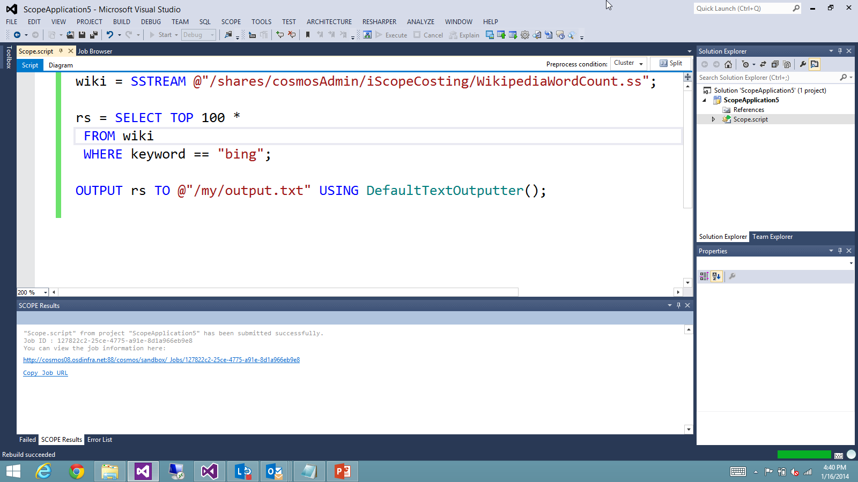

Slide 70
Scope Studio
Job Profile Animation

Slide 71
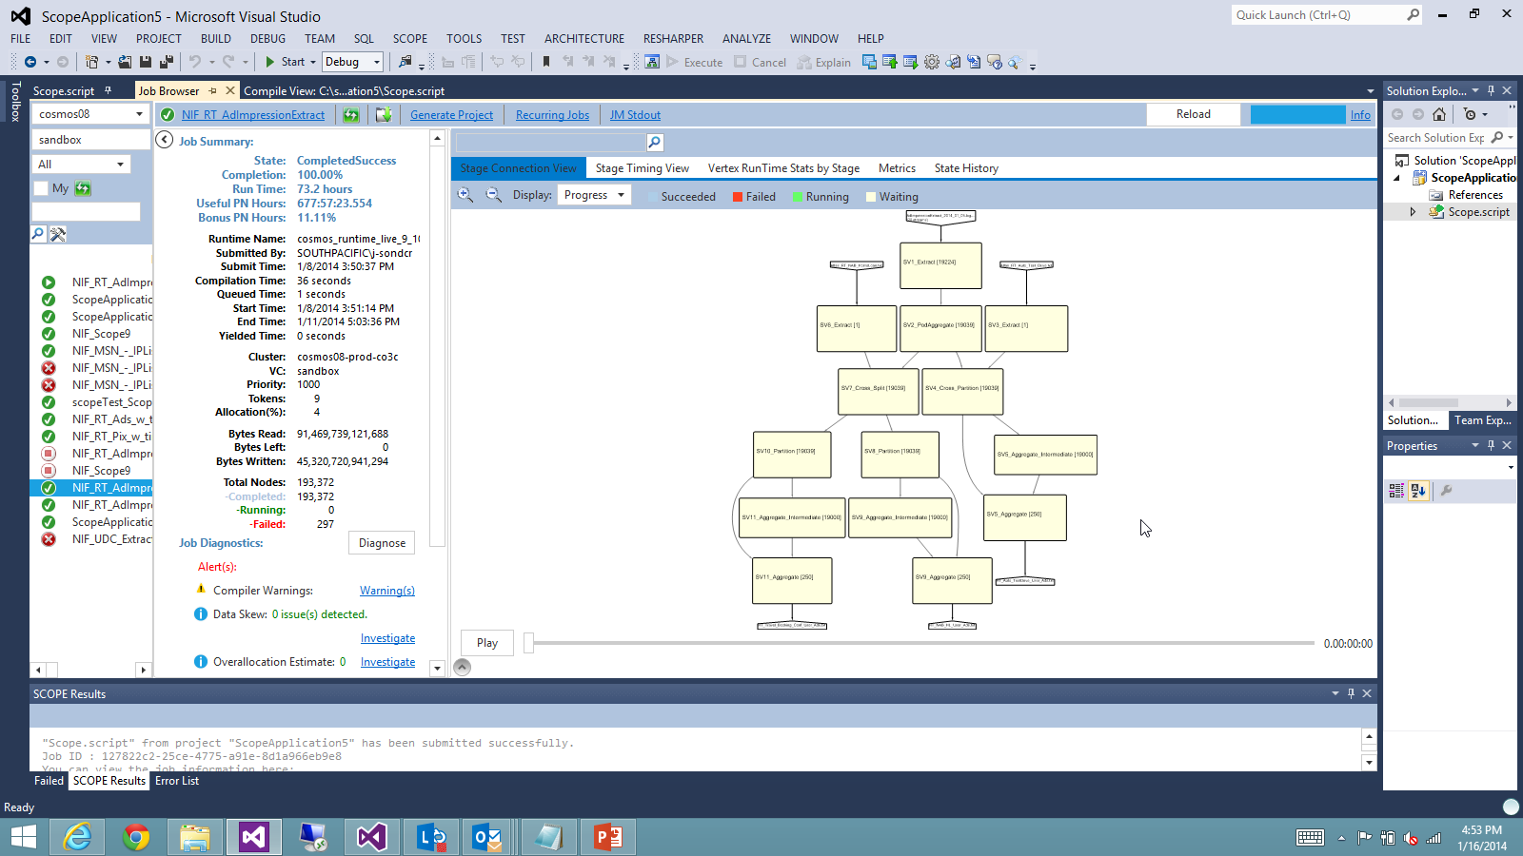

Slide 72
Scope Studio
Job Diff

Slide 74
Recurring Job Analysis

Slide 75
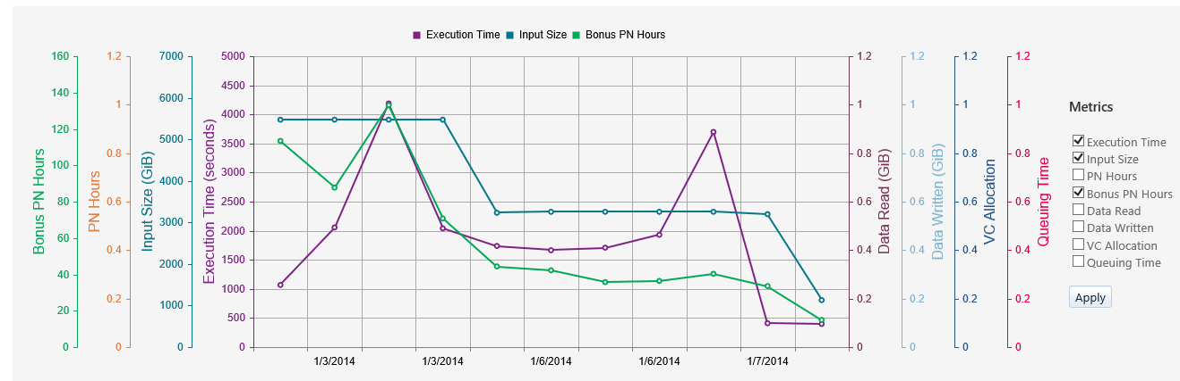

Slide 76
Manage Storage Capacity

Slide 77
BingDex

Slide 78
